Slide 1
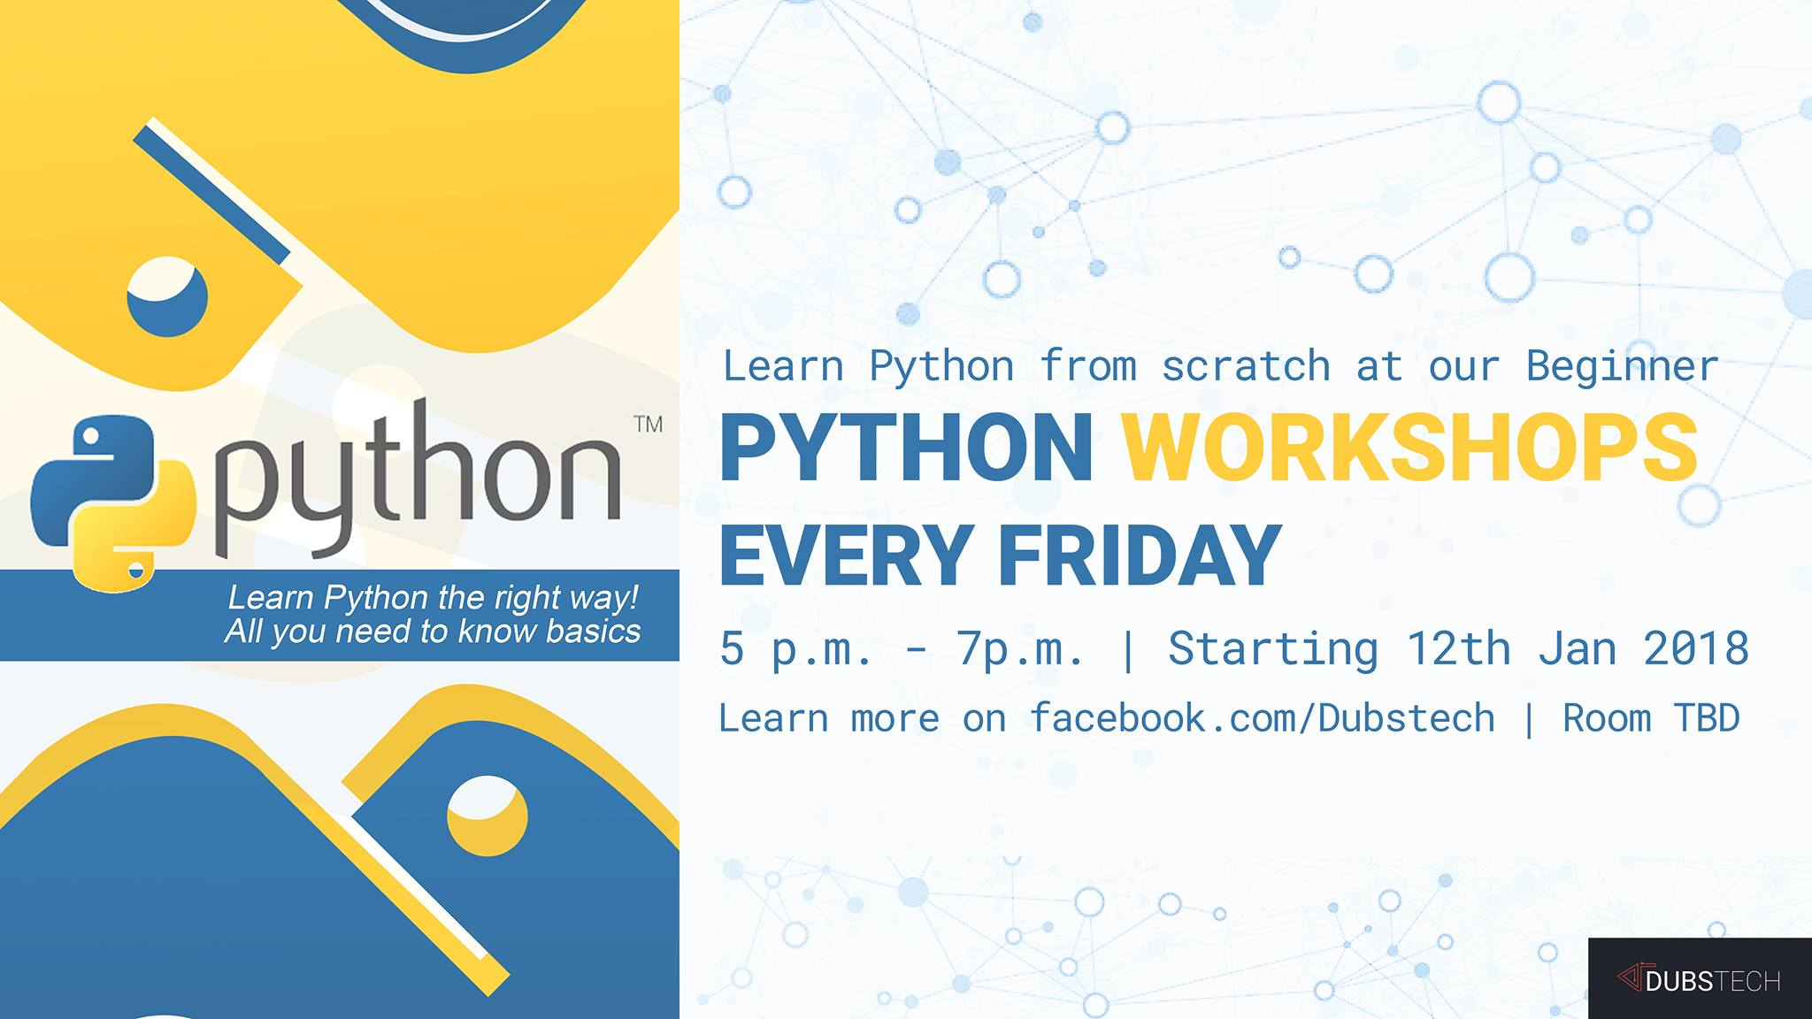

Slide 2

Fun with Python
DubsTech Coding Intro Workshop
Bowen Xu
bwx074@uw.edu

Slide 3
Welcome to DubsTech!
A UW RSO for diversified tech fields
Aiming to bring the coolest tech to everyone
Like us on facebook.com/Dubstech

Slide 4
About the Coding Intro Workshop
Learn how to code in Python
Explore your interest in coding
New projects every workshop
All you need to do: bring your laptop
No rushing, no homework, no stress!

Slide 5
How the workshop works
Show you how the project works
Talk about the general aspect(s) behind it
Walk you through the coding
That’s it! Everyone will get their projects completed
Show your projects to your friends! Help us grow!

Slide 6
Before we start…
Go to thonny.org
Download the latest version of Thonny on the upper right corner
For Mac installation, refer https://bitbucket.org/plas/thonny/wiki/MacOSX
Launch Thonny, a beginner friendly IDE (“code editor”)
Use a dedicated workspace folder and store all your codes in one place!
I’ll walk around and help with the installation

Slide 7
Workshop 1: Dice Rolling Simulator
simpleDice3.py

Slide 8
Thought it was fun?
How complex do you think the program is? (How many lines of code?)
What aspects of coding do you think the simulator includes?
How does the program “accept” and “process” our keyboard input?
How does the program “roll” a fair dice?
How does the program “tell” the number?

Slide 9
The reveal
Just 15 lines of code, including blanks! But it includes:
Input/Output (I/O)
If/else iteration
Helper methods

Slide 10
Let’s code… step by step
Everyone makes mistakes!
Bugs can build up and become harder to find
Think about the actions (methods) you take, and
approaches (generic functions) you make
Methods: codes you wrote yourself. Helps with factoring out codes and debugging!
Generic functions: built-in features/methods you can use to save time

Slide 11
simpleDice.py
Let’s roll ONE dice for now. What do we need?
“rolling” (original, methods)
Generate random numbers (generic, functions)
Output (generic, functions)

Slide 12
Python Syntax basics
def a_method(): #parameters goes inside ()
a_text = "Hello world"
a_number = 12345
#variable names on the left, values on the right
#in Thonny, use View -> Variables to keep track
print(a_text)
return a_number
def main():
print(a_method()) #prints 12345
main() #method(s) listed here will be executed directly
Colored words in Python include:
Name of methods
Reserved words (for built-in functionalities)

Slide 13
Method basics
helloWorld_void.py
Thonny -> File -> New
Use camelCase or under_line to properly name your variables
More data types in Workshop 2
Indentation is everything to python!
Every time you write code blocks that BELONGS to some code, INDENT!
Think about indentation in python as paragraphs for essays:
Codes work only when correctly indented
Essays are readable when correctly segmented into paragraphs
From outside to inside, each layer has its own job (meaning)

Slide 14
Reserved words
Colored words in Python codes are reserved words
They have certain meanings and own functions

Slide 15
Void methods vs returning methods
helloWorld.py
Void methods does its work and exits
Return methods returns something upon exiting

Slide 16
Let’s get random
RandomDice.py
Writing tester methods helps with locating bugs ASAP!
Notice num_rolled in roll() and tester() methods do not interfere:
Variables only exists in methods
What if you want a global variable that’s accessible to the entire program? (workshop 2)

Slide 17
simpleDice.py – complete!
We want a main() method to print out a message, not only the number itself
Python allows you to call multiple methods for direct execution, but
there’s a tradition from other languages (e.g. Java) to keep the role of calling methods in one place – the main() method
I’ll walk around and help with you writing:
simpleDice.py
When finished, Run -> Run Module to see your work!

Slide 18
simpleDice2.py
Want to roll a second dice?
Add another variable, call the roll() method again and print()!
Understand the benefits of methods now? Minimal redundancy!
I’ll walk around and help with you writing:
simpleDice2.py

Slide 19
simpleDice3.py
Does the user actually want the second dice?
To make rolling the second dice optional, we need:
Accepting user input
Interpreting user input
Based on user input, make parallel actions (if/else)

Slide 20
If/else
ifElse.py
Remember to use:
== to compare if things are equal
(Note: unlike other programming language, the Python compiler will complain if you use “=“ instead of “==“ in if statement)
!= to compare if things are NOT equal
For >, <, >=, <=, you know the drill!

Slide 21
simpleDice3.py – complete!
If we ignore bad user input now, what are the ONLY two scenarios of input?
If yes: we roll the second dice
If no: we do nothing
There’s no need to write the else case here!
More if/else logic: Workshop 2
I’ll walk around and help with you writing:
simpleDice3.py

Slide 22
Reflections
In real world scenarios we could never ignore bad inputs
What if the user want to roll dices… for 100 times?
Do they need to launch the program over and over?
Or is there a way to LOOP the rolling?
LoopedDice.py
See you in Workshop 2, where we fix all the problems and write our own Magic 8!
Credits to Webucator

